Slide 1
PROJECT CIPHER
FINAL PRESENTATION
CIPHER CRYPTOGRAPHY SERVICE
___________________________________________________________
-
-
ADVANCED Substitution Cipher
________________________________
Operation: BDAT 1001-21F
User: Landon Lyle
Clearance ID: 200421088
Synergy Intelligence Security Firm

Slide 2
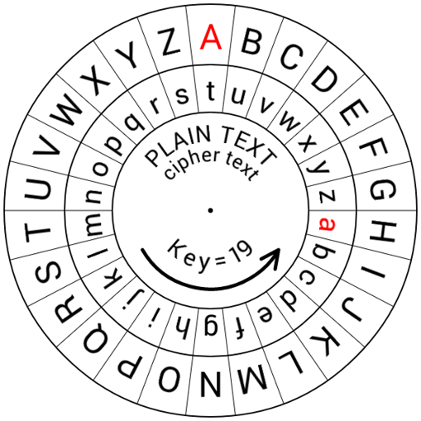
What is PROJECT CIPHER
Project Cipher is a Government intelligence project that was created to break the highest levels of encryption.
The Project aims to Encrypt & Decrypt messages that are saved into a secure SQL Database.
Using a “Substitution Cipher” the application will encrypt a message and save it to the database.
Moving each character in the encoded string alphabet the next character value will ensure security.
Decrypting in performed on the same bases, it takes the encoded string and substitutes the values in reverse order of the characters values that where set in the encoding process.

Slide 3
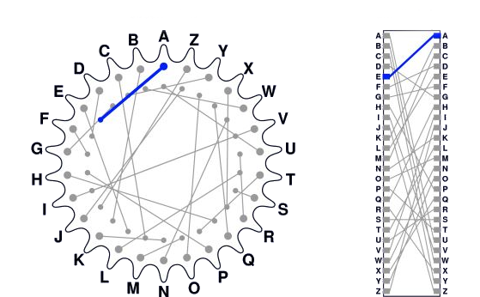

Cipher ENCRYPTION
How it works
There is an alphabetical string of characters that represent 26 points assigned to the alphabet.
Using substitutions we replace the character “A” for character “B” and the same for each other character of the alphabet. The plain text is then converted to ciphertext.
Based off of the Caesar Cipher.
26 Keys each represent an alphabetical character.
“Around 88bit Encryption”

Slide 4

CIPHER DECRYPTION
How it works
Encoded secret Message
The Decryption process required during the decoding process is the reversal of encryption.
Encoded Message retrieved from SQL database.
The Encrypted strings character position in shifted in reverse order of encryption method.
“JDG YJUE OG OPSDF KOSDF PWVRS YJRMNE ON
JDUIWA GJS OSDFJP JG TYJE JE LOSDFSJFE JSDF”

Slide 5
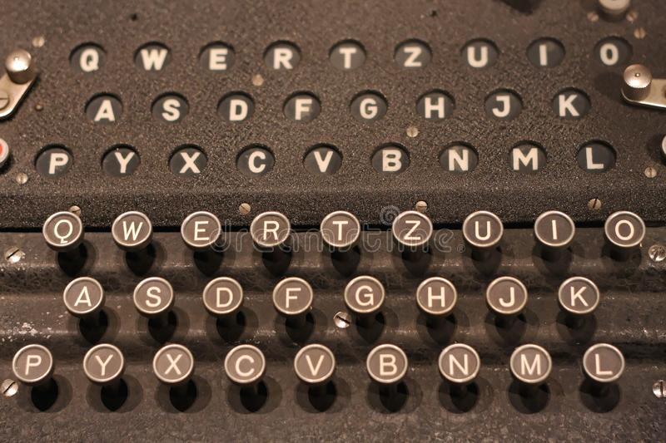




CIPHER cryptography service
Our service is a remote encoded database messaging forum. To simulate the use of encrypting and decrypting messages saved in an SQL Database.
The application is written in Visual Studio 2019 using C# language.
SQL Server Management Studio is used to store the users name and salt and hash their password to secure login.
A local database will store the encrypted secret message that was transmitted from the application.
Only secured users to the application can view the message forum, encrypt & decrypt messages that are stored in the local database.

Slide 6
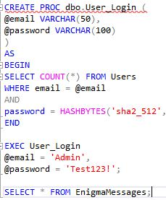
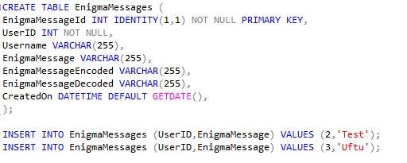
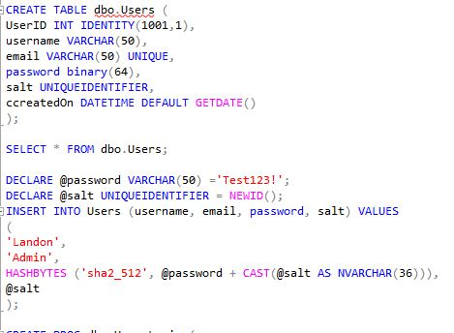
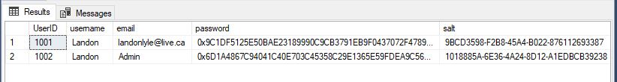
SQL DATABASE
How it works
The user creates a username and password in the SQL database.
Procedure that changes the password form to hash bytes then salts the password
This enables login to reference the hashed password versus the users actual password string.

Slide 7
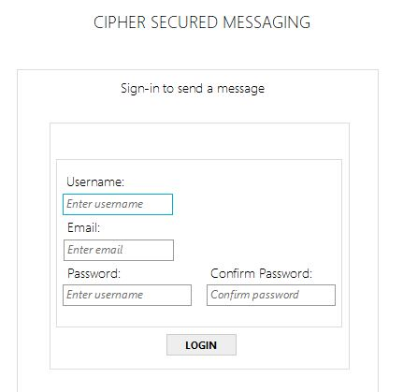
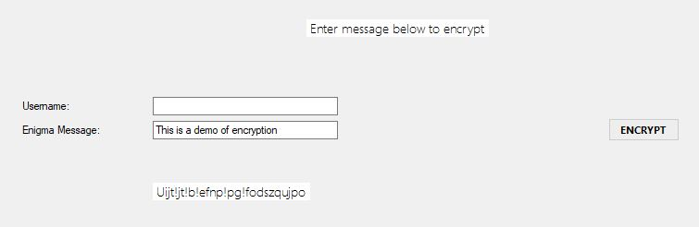
Application
How it works
The user enters there username and password to login.
Once login security is checked the user can view encrypted messages saved in the database for them to decrypt and read.
The user can then enter a message to encrypt.

Slide 8
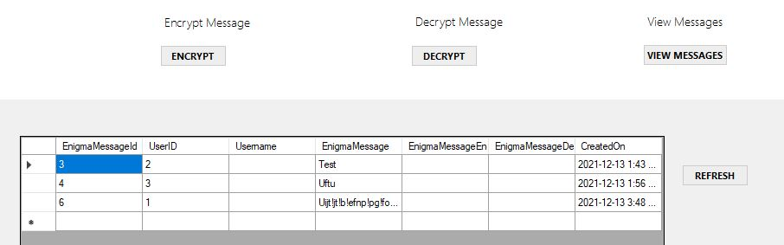
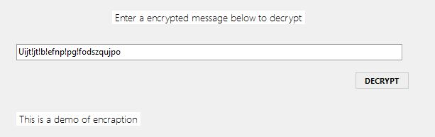
Application CONT…
How it works CONT…
The user enters there username and password to login.
A message forum display a list of encrypted messages left for the user to decrypt and read.
There is a decrypt button to allow the user to enter the encrypted string for decryption.

Slide 9
APPLICATION DEMO

Slide 10
Thank YOU
Thank you for using the Cipher Cryptography Messaging Service
To securely store your messages.

